Slide 1




NEXT GEN EMPLOYABILITY PROGRAM
Creating a future-ready workforce
Team Members
College Name
Student Name : KATHIRBALA M
Student ID : 21CS005
8155 - SURYA COLLEGE OF ENGINEERING

Slide 2

CAPSTONE PROJECT SHOWCASE
Project Title
Moozeek WEB APPLICATION USING DJANGO FRAMEWORK
Abstract | Problem Statement | Project Overview | Existing System:| Proposed Solution: | Architecture Diagram | Conclusion

Slide 3
Abstract
The primary purpose of this music website is to play, music available in the database of the service, compose custom playlists and suggest similar songs.
And with the support of different home pages it make the user interface more interactive and easier by suggesting different genres of music like sad, love, lo-fi, pop songs etc., and also by providing pre- created playlist according to the users mood.
Source :

Slide 4
Problem Statement
Storage: as now it's an era of online streaming many face problems with number of songs you can store up in your device proportionate with device storage.
Bugs/errors: no matter how many tests and reports are executed for any websites we find various number of unwanted bugs and errors.
User interface: the user interface is a key role for deciding a website for music for the user.
Source :

Slide 5
Existing System:
Music websites serves up many objectives and goals for increasing the number of users and making the developer more aware about the problems facing and fixing them to improve.
All the mainstream music website at present aims to provide high quality of music for user irrespective of which device they are using.
Having good user and creator relationship leads to increase in number of user and enhance collaboration with different platforms where the application can be brought under
Source :

Slide 6
Proposed Solution:
.
Adding up API - In future we plan to add API system SO that we can receive music input from various websites like YOUTUBE MUSIC, SOPTIFY, YOUTUBE Chat bot- Adding up of chat bot to the system makes the system more interactive for the user and generates music suggestions.
Music Video- For premium user for our website we would like to propose music videos which come along the latest music
Source :

Slide 7
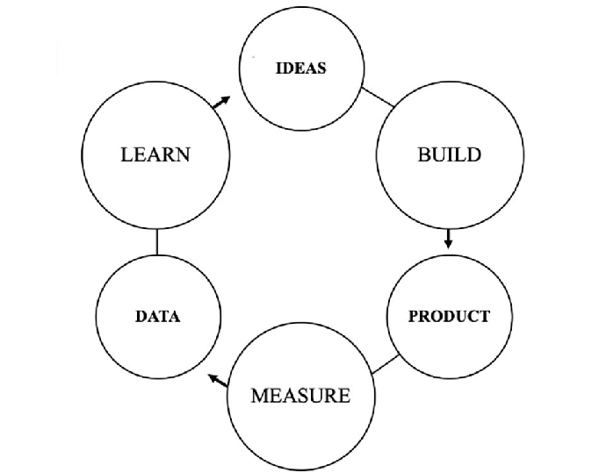
Architecture Diagram:
Here we have used the basic software front end design model in order to represent the system architecture of our software model. The above is a simple form of system design diagram which uses front end design.
This shows a loop of functions that need to be executed when this project is implemented. This is a chain of operations through which this project is implemented.
Source :

Slide 8
Module Description:
This is a website which is designed using CSS, Java Script and HTML for its frontend as well as its backend design.
The music website "VIBE" is meant to play music which have been made available to the backend of the project. Its is provided with different interactive buttons like PLAY/PAUSE and NEXT/BEFORE.
Also with different pages in accordance with the type of the music the user wants to listen
Source :

Slide 9


Technology Used
Front-end
Back-end
Source :

Slide 10
CODING:
"""Django's command-line utility for administrative tasks."""
import os
import sys
def main():
os.environ.setdefault('DJANGO_SETTINGS_MODULE', 'music.settings')
try:
from django.core.management import execute_from_command_line
except ImportError as exc:
raise ImportError(
"Couldn't import Django. Are you sure it's installed and "
"available on your PYTHONPATH environment variable? Did you "
"forget to activate a virtual environment?"
) from exc
Source :

Slide 11
execute_from_command_line(sys.argv)
if __name__ == '__main__':
main()

Slide 12

Homepage

Slide 13
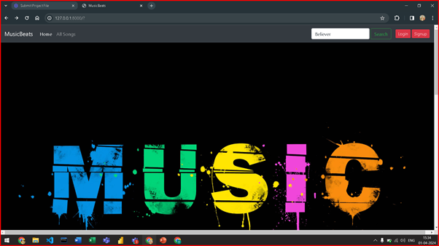
SCREENSHORTS

Slide 14
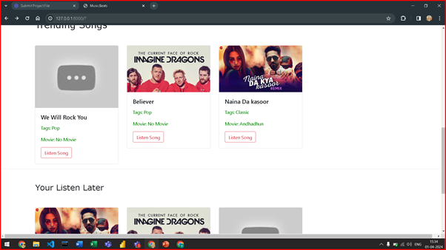

Slide 15
Conclusion
The entire project has been developed and deployed as per the requirements stated by the user.
It is found to be bug free as per the testing standards that are implemented.
The whole system's activities divided are into three major parts like Student, Teacher, and Admin.
We would be needing more ding resources to make it a full fledge website using API to take music from different music websites like Youtube music and spotify and update with a chat bot in future
Source :

Slide 16
Thank You!
Notes:
Thank You !!

